Slide 1

Unsupervised Learning applied to Customer Lifetime Value (CLV)
Astin 2021
online Colloquium
Wed May 19th, 2021 Claudio Giorgio Giancaterino

Slide 2
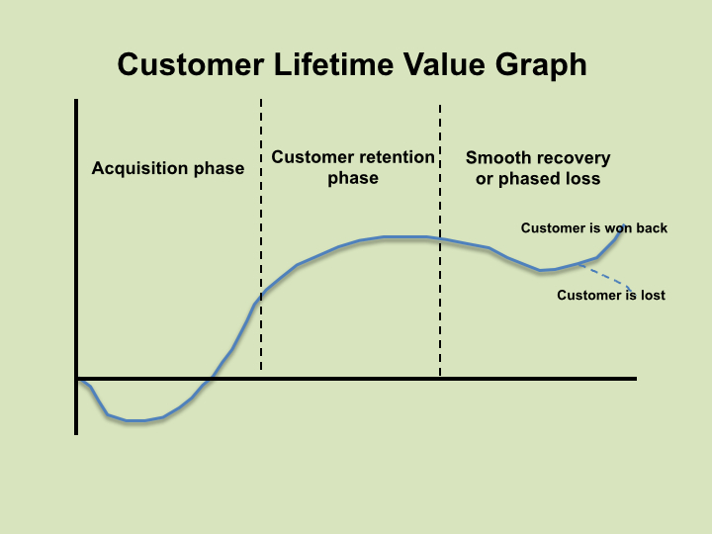

SPREAD PREDICTIVE ANALYTICS TOWARDS INSURANCE MARKETING FIELD
A key tool: Customer Lifetime Value.
It’s the value of a customer for a Company over the span of their lifetime relationship.
Github repository: https://github.com/claudio1975/Customer_Lifetime_Value

Slide 3
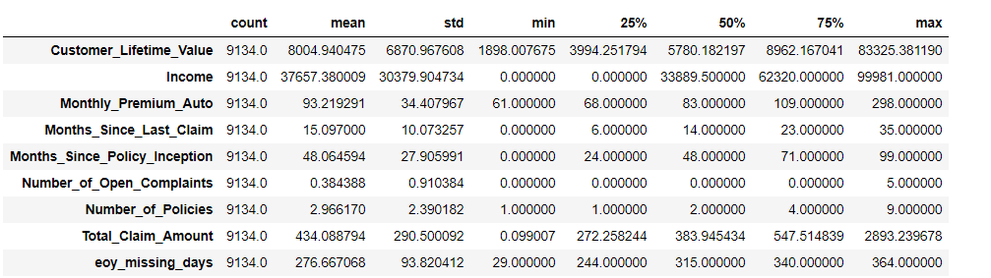
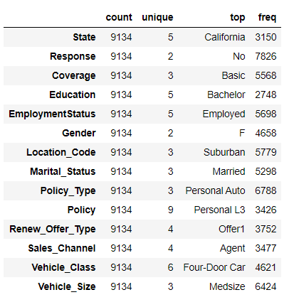
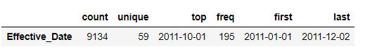
USE CASE: AUTOINSURANCE DATA SET

Slide 4
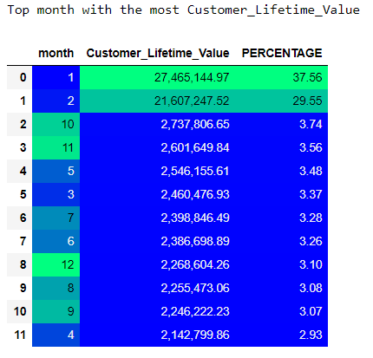
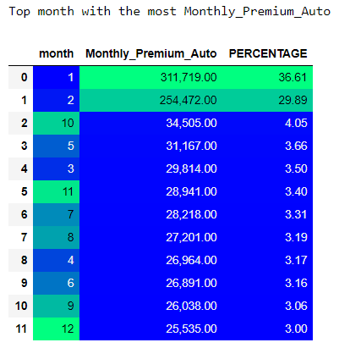
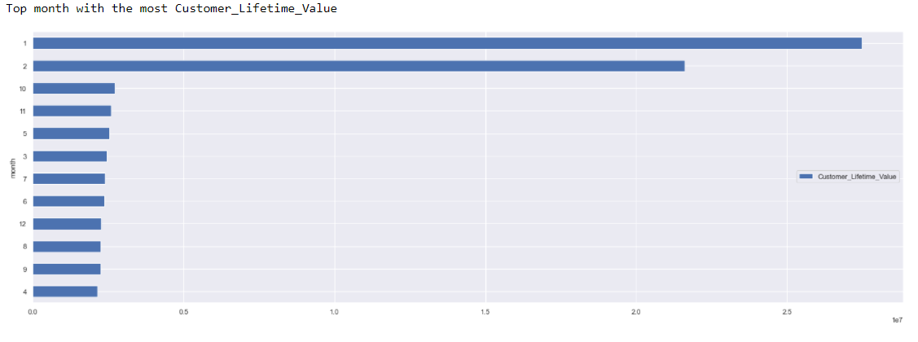
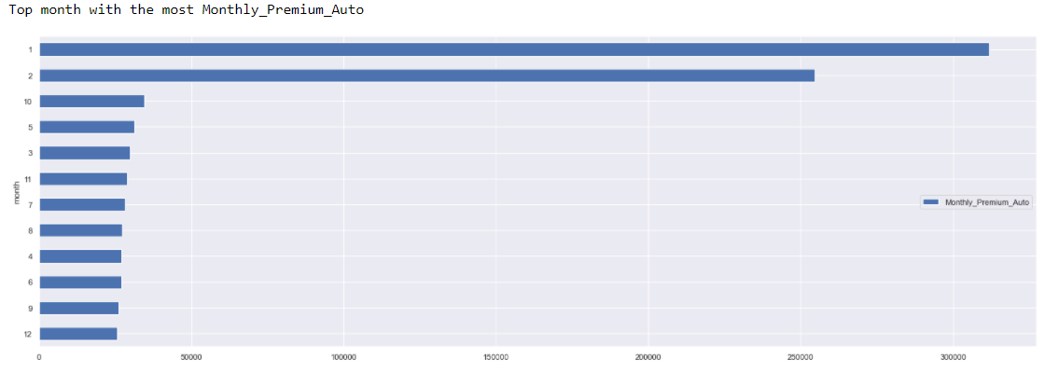
Distribution of CLV and Monthly Premium Auto in the year

Slide 5
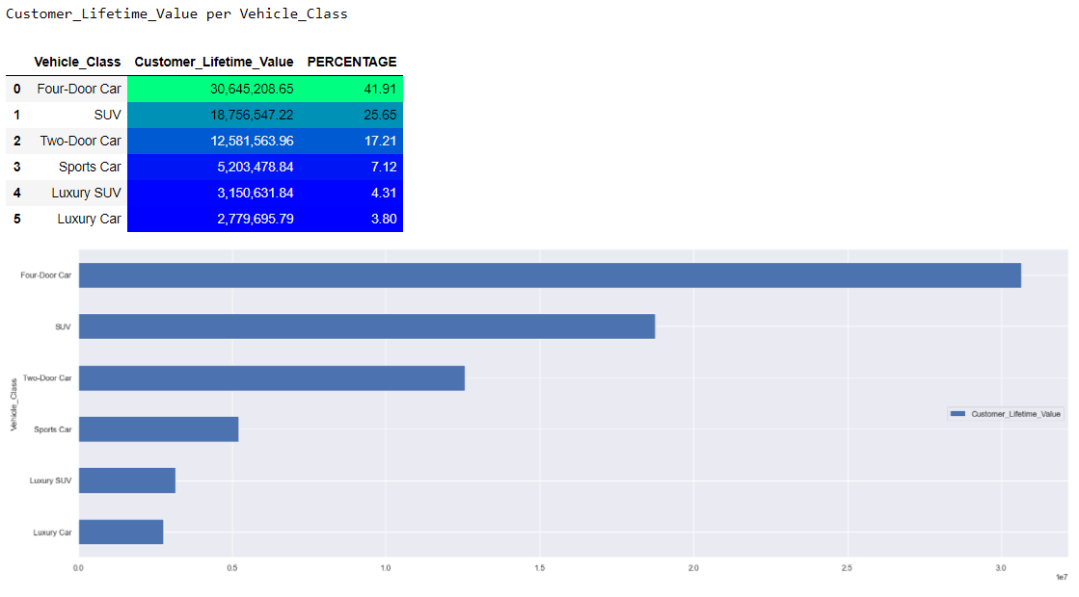
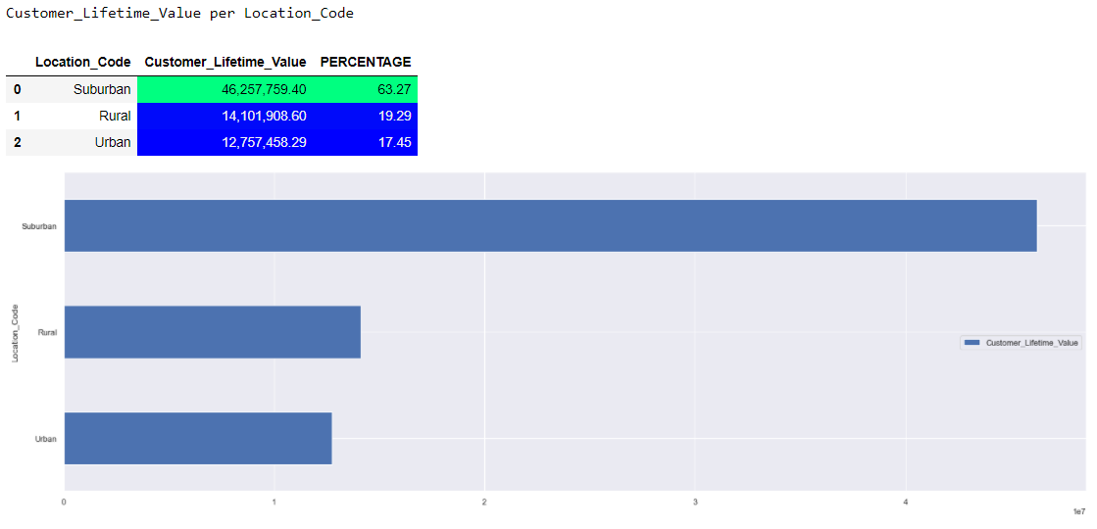
Distribution of CLV on 2 features: Vehicle class and Locaton code

Slide 6
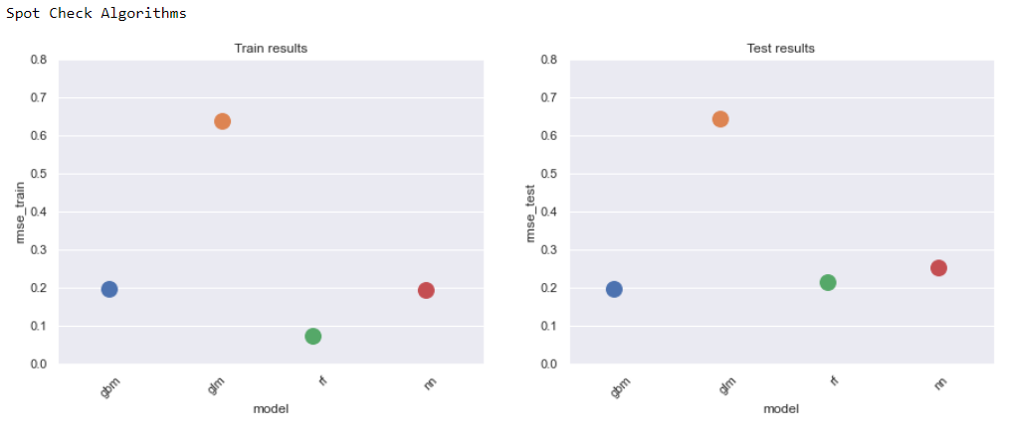
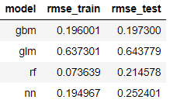
Which model can I use to predict CLV?
Generalized Linear Model (GLM)
Random Forest (RF)
Gradient Boosting Machine (GBM)
Neural Networks (NN)
....and the winner is…..GBM!!! It is used as flat model for next experiments!!!

Slide 7
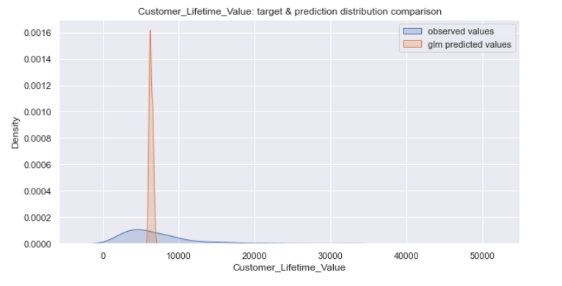
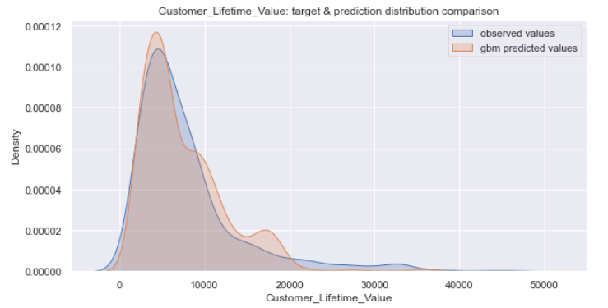
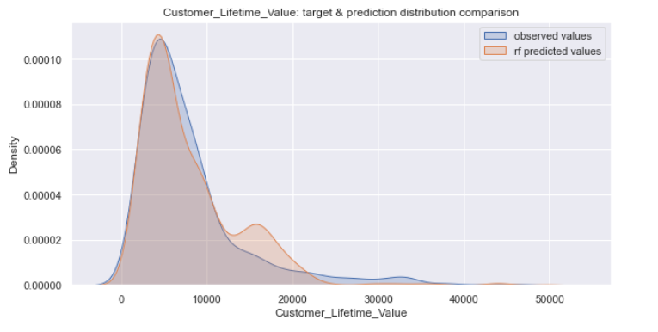
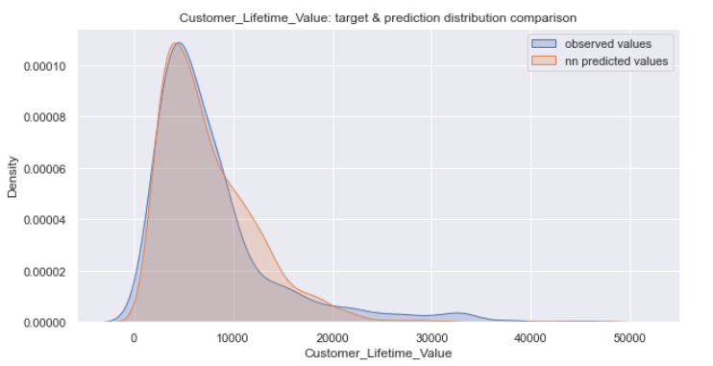
Distribution of CLV models
GLM
GBM
RF
NN

Slide 8
Unsupervised Learning
Unsupervised Learning describes tasks that involves using a model to discover a good internal representation of input data useful for subsequent Supervised Learning.
Dimensionality Reduction:
it is the process of reducing the amount of features to a set of principal variables
Clustering: it is the process used to discover inherent groupings in the data
Anomaly detection: it is the process used to discover unusual data points in the data set
Association: it is the process used to discover sets of items that frequently occur together in the data set

Slide 9
Principal Component Analysis (PCA)
Principal Components Analysis, by an orthogonal transformation, finds principal components, a sequence of linear combinations of the variables that have maximal variance, and are mutually uncorrelated. This linear transformation fits the data set into new variables (coordinates) where the eigenvectors called loadings represent the directions of the principal axes, whereas the eigenvalues represent the amount of variance that principal components capture from the data when they are projected onto these axes. The principal components are a straight line, and the first principal component holds the most variance. Each following principal component is orthogonal to the last one and has a smaller variance.

Slide 10
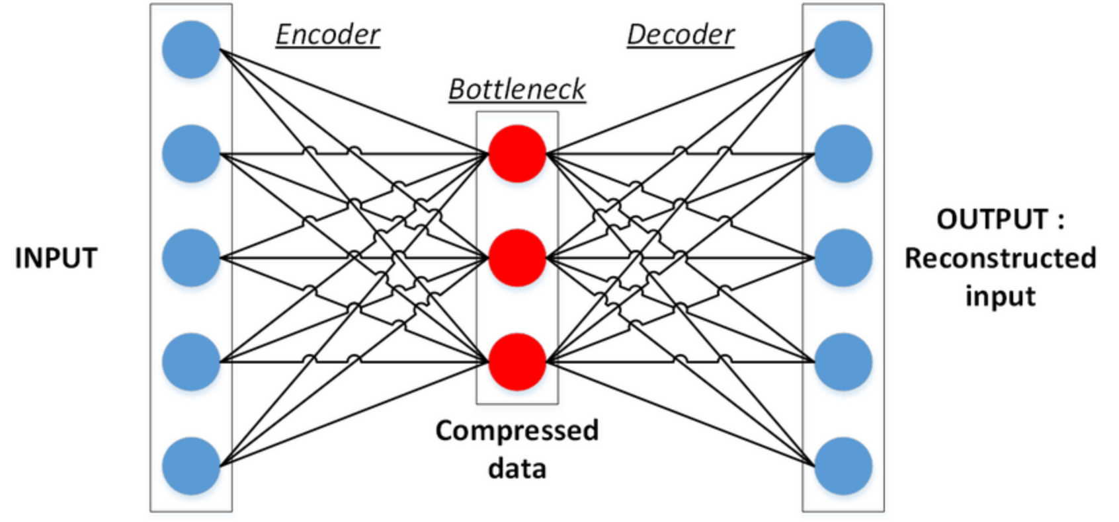
Autoencoders
Autoencoder, like PCA, is a tool to find a lower-dimensional representation of high-dimensional data, but unlike PCA is able to capture non-linearity using activation functions. Autoencoders are Neural Networks where the output layer has the same dimension of the input layer. An autoencoder replicates the data from the input to the output in an unsupervised manner, reconstruct each dimension of the input by passing it through the network. During the replication process, the size of the input is reduced into its smaller representation held in a latent space then the output is reconstructed from this reduced representation of the input. The architecture of an Autoencoder is based on:
-Encoder: it is a feedforward neural network that compresses the input into a latent space representation.
-Bottleneck: the middle layer of the network that contains the reduced representation of the input that is fed into the decoder.
-Decoder: it is also a feedforward neural network like the encoder and rebuild the input back to the original dimensions from the bottleneck.

Slide 11
Isomap
Isomap, a.k.a. isometric mapping, is a non-linear dimensionality reduction method based on the spectral theory which tries to preserve the geodesic distances in the lower dimension. Isomap starts finding nearest neighbours to each sample, and after that, it uses graph distance to estimate the geodesic distance between all pairs of points computing their shortest path distances. At the end, through eigenvalue decomposition of the geodesic distance matrix, it builds the low dimensional embedding of the data set.

Slide 12

T-Sne
t-Distributed Stochastic Neighbor Embedding (t-SNE) is a non-linear method for dimensionality reduction and it’s used to explore high-dimensional data sets. The algorithm starts by converting the high-dimensional Euclidean distances between data points into conditional probabilities that represent similarities. Then it computes a similar conditional probability for the low-dimensional data points corresponding to the high-dimensional data points. After that it tries to minimize the difference between these conditional probabilities (or similarities) using a gradient descent method. t-SNE try to minimize the divergence between two distributions, it finds patterns in the data discovering clusters based on similarity of data points with multiple features, but it isn’t a clustering.
From: https://github.com/oreillymedia/t-SNE-tutorial

Slide 13
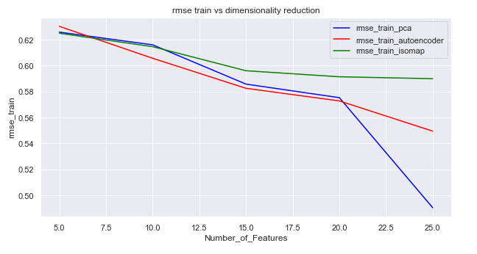
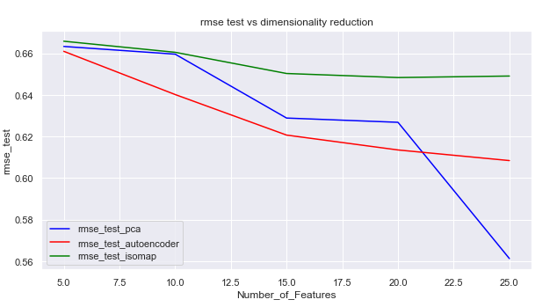
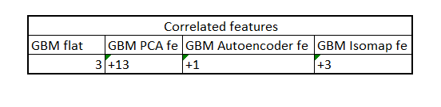
Evaluation error of dimensionality reduction by GBM
….and by correlation with features from original data set

Slide 14
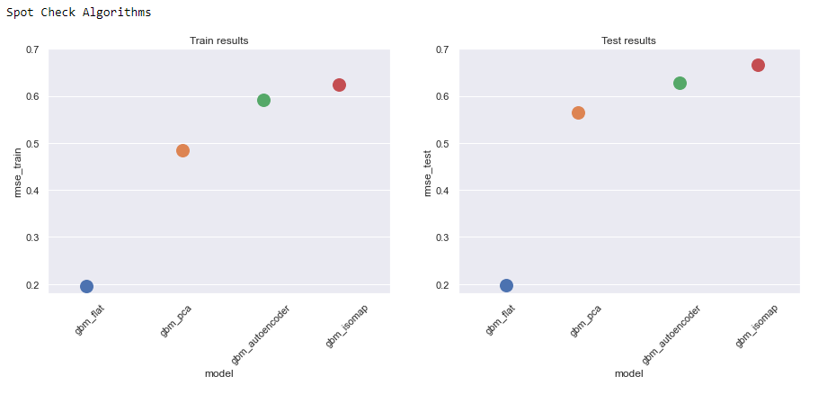
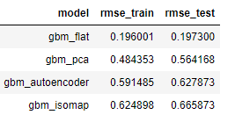
Evaluation of CLV performance using
features from dimensionality reduction

Slide 15
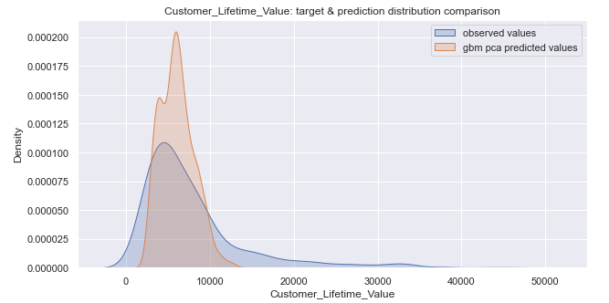
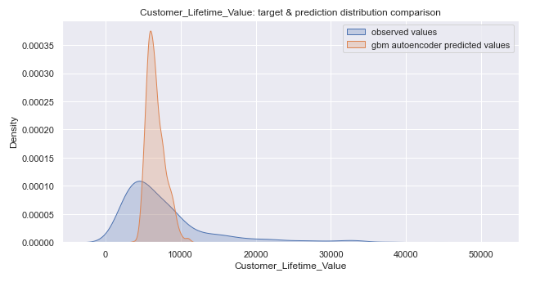
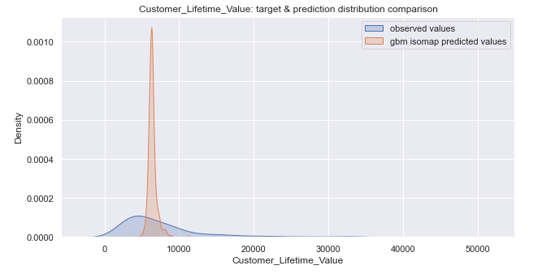
Comparison between Flat model and others built with features from dimensionality reduction
Flat
PCA
Autoencoders
Isomap

Slide 16
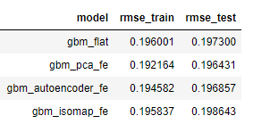
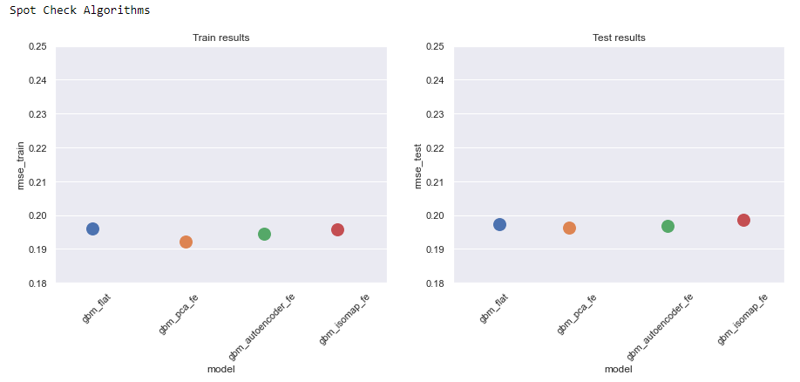
Evaluation of CLV performance adding
Features from dimensionality reduction

Slide 17
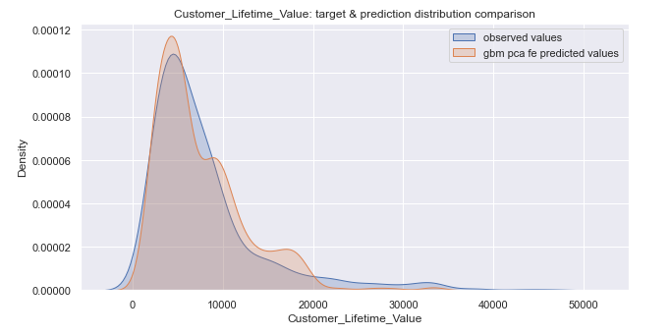
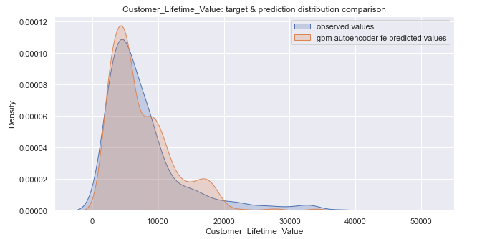
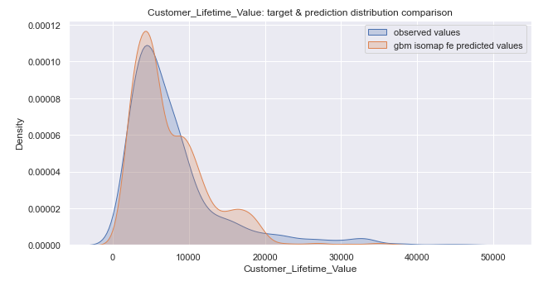
Comparison between Flat model and others built adding at the original data set features from dimensionality reduction
Flat
Flat adding pca features
Flat adding autoencoders features
Flat adding isomap features

Slide 18
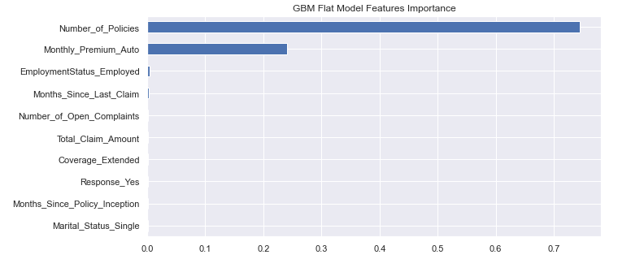
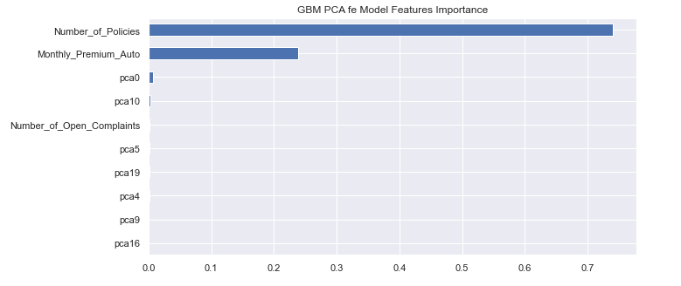
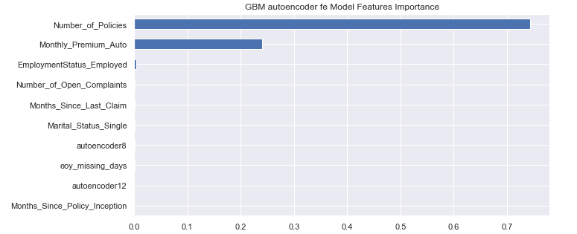
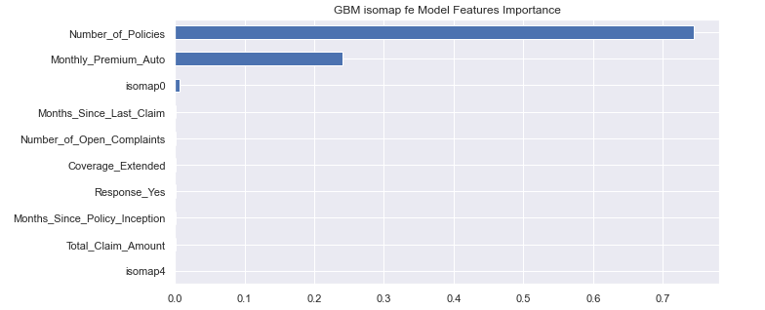
Features importance from Flat model and others built adding at the original data set features from dimensionality reduction

Slide 19
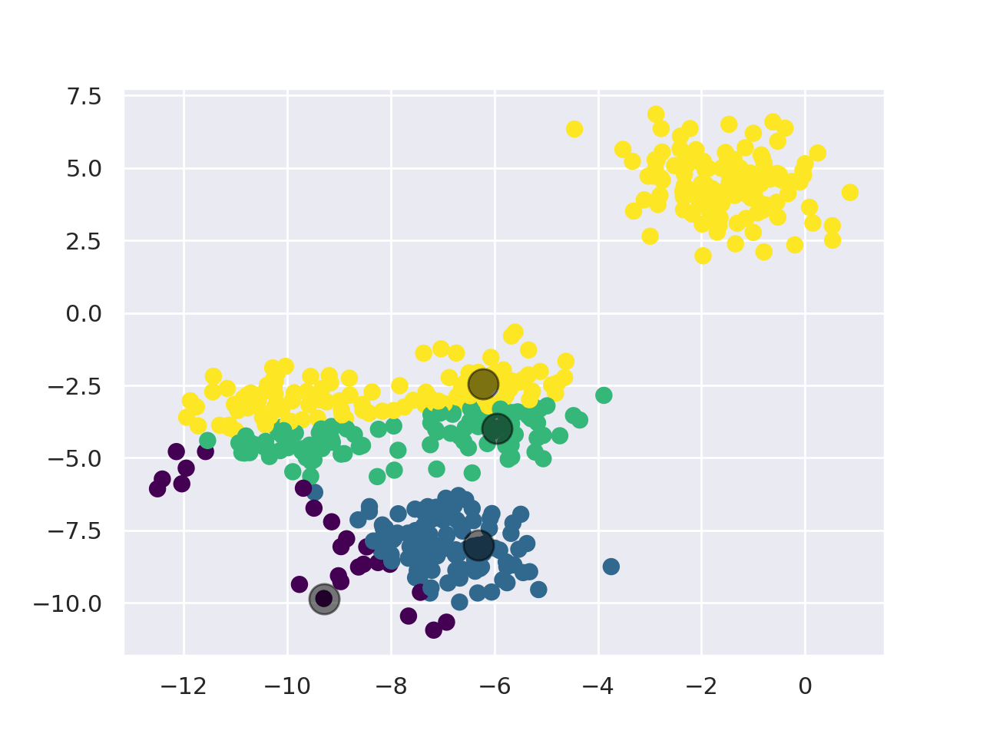
K-Means
K-Means is a centroid-based clustering that try to minimize the distance between each point to the assigned cluster centroid. It starts to pick a number of clusters, k, and for each one calculates the coordinates of its centroid. Points are assigned to the nearest cluster centroid, after that, centroids position are re-computed by the mean of all observations assigned to the cluster. It’s an iterative process until centroids don’t change much between iterations anymore.
From: https://ml-explained.com/blog/kmeans-explained

Slide 20
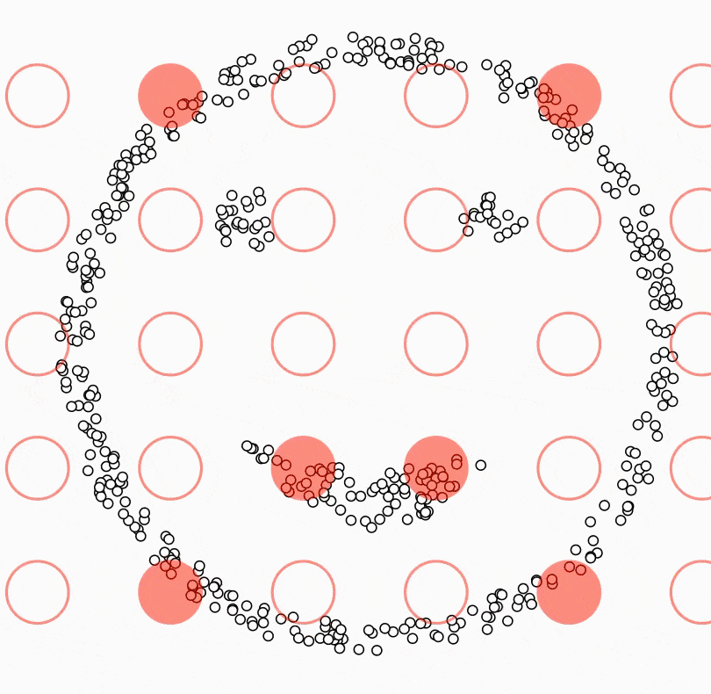
DBSCAN is a density-based clustering algorithm that defines clusters as continuous regions of high density, grouping together points with many nearby neighbours and marking outlier points in low-density regions. It starts picking a point at random and retrieves its neighbourhood. If it is a core point (it has at least min number of points “minPoints” within a distance “ε” used to locate neighbourhood), it will start a new cluster expanded by assigning all points in its neighbourhood to the cluster. If an additional core point is found in the neighbourhood, the search is extended to include all points in its neighbourhood. If no more core points are found, the cluster is complete, and remaining points are examined to look for other core point to start a new cluster. Points not assigned to a cluster are considered noise.
DBSCAN
From: https://ml-explained.com/blog/dbscan-explained

Slide 21
Gaussian Mixture Models
Gaussian Mixture Models clustering is a generalization of K-Means. Instead of using a distance-based model, will be used a distribution-based model. In K-Means clusters are circular as a result of using the mean as centroid. With GMM will be assumed data points are Gaussian distributed with clusters that can take any kind of elliptical shape and each Gaussian distribution is assigned to a single cluster. The Expectation-Maximization optimization algorithm is used to find the parameters of the Gaussian distribution for each cluster.

Slide 22
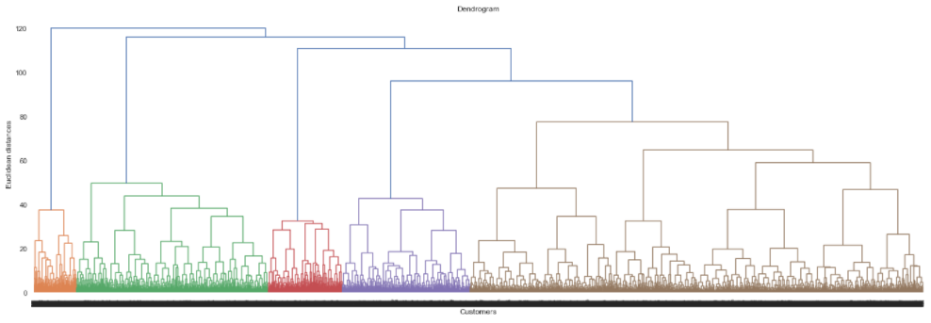
Hierachical Clustering
Hierarchical clustering builds hierarchy of clusters by a bottom-up approach. It starts with all points assigned to a cluster of their own, so given N observations will have N clusters. Find a pair of clusters with the smallest cluster-to-cluster distance. Merge the two clusters into one, reducing the number of clusters to N-1. The process go ahead till all points are merged into one cluster, the root cluster. The result of hierarchical clustering can be shown by a dendrogram.

Slide 23
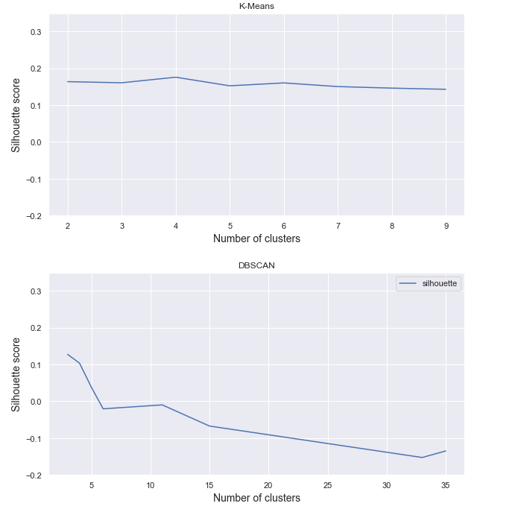
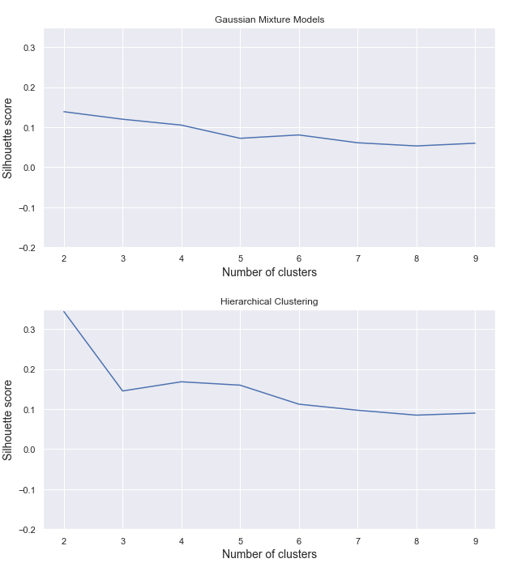
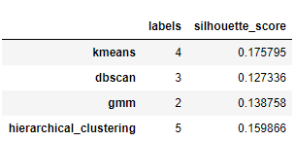
Clustering Analysis
Clustering algorithms evaluated by silhouette score

Slide 24
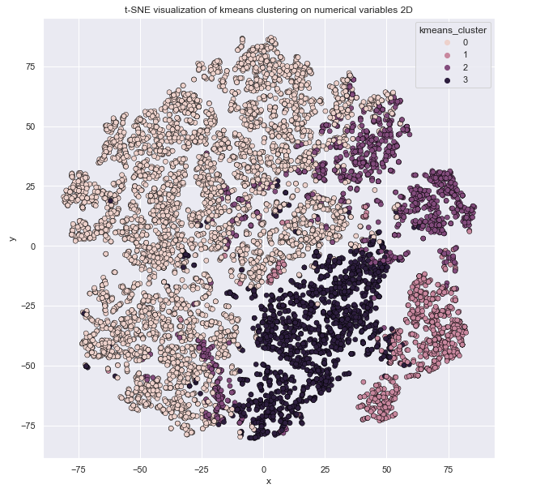
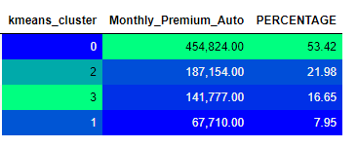
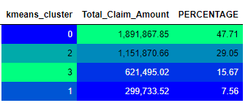
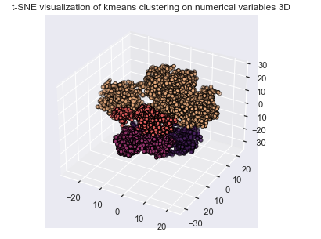
K-Means results

Slide 25
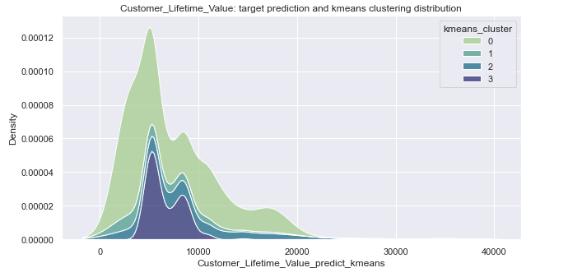
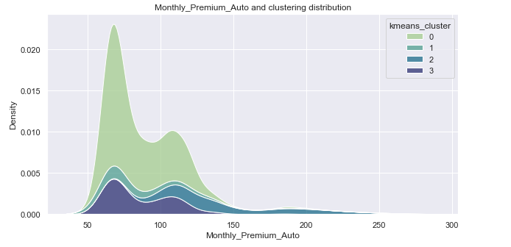
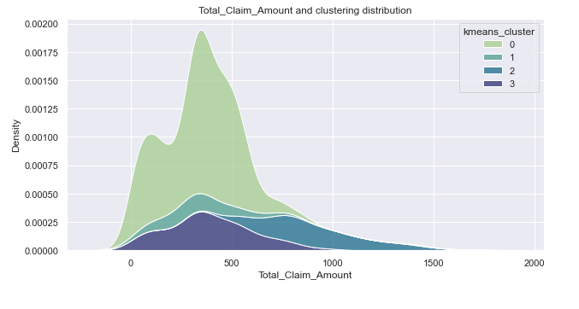


Slide 26
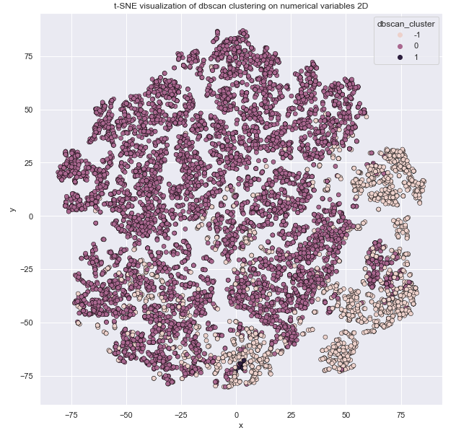
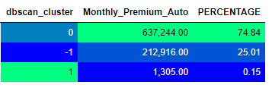
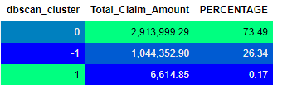

DBSCAN results

Slide 27





Slide 28




GMM results

Slide 29





Slide 30




Hierarchical Clustering results

Slide 31





Slide 32
Conclusions
Opportunity to use features extracted by dimensionality reduction tools as new additional features
Clustering can improve a portfolio and strategy analysis
Some models give good performance but are quite a black-box
References
T. Hastie, R. Tbishirani, J. Friedman, “The Elements of Statistical Learning”, 2017, Springer
M. V. Wutrich, S. Rentzmann, “Unsupervised Learning: What is a sport car?”, 2019, SSRN.
I. Goodfellow, Y. Bengio, A. Courville, “Deep Learning”, 2016, MIT Press
Yoon Hyup Hwang, “Hands-On Data Science for Marketing”, 2019, Packt
G. Bonaccorso, “Hands-On Unsupervised Learning with Python”, 2019, Packt

Slide 33

???
Contacts: c.giancaterino@gmail.com

